Slide 1


Linear Algebra Query
Since linear algebra isn’t a formal pre-requisite for this class, I want to know how much (if any) linear algebra you know.
Question:
If $π_{1}=[0 0.5 0.5]$ and $P=\left[\begin{matrix}0 & 0.5 & 0.5 \\ 1 & 0 & 0 \\ 0.5 & 0.5 & 0\end{matrix}\right]$, what is $π_{2}=π_{1}P$?
https://joshh.ug/A

Slide 2

Linear Algebra Query
Since linear algebra isn’t a formal pre-requisite for this class, I want to know how much (if any) linear algebra you know.
Question:
If $π_{1}=[0 0.5 0.5]$ and $P=\left[\begin{matrix}0 & 0.5 & 0.5 \\ 1 & 0 & 0 \\ 0.5 & 0.5 & 0\end{matrix}\right]$, what is $π_{2}=π_{1}P$?

Slide 3
Markov Chain Introduction
Markov Chain Introduction
Generating Samples from a Markov Chain
Hitting Time
Applications of Hitting Time
Probability of A Before B
The Invariant Distribution
Lecture 25, CS70 Fall 2025

Slide 4
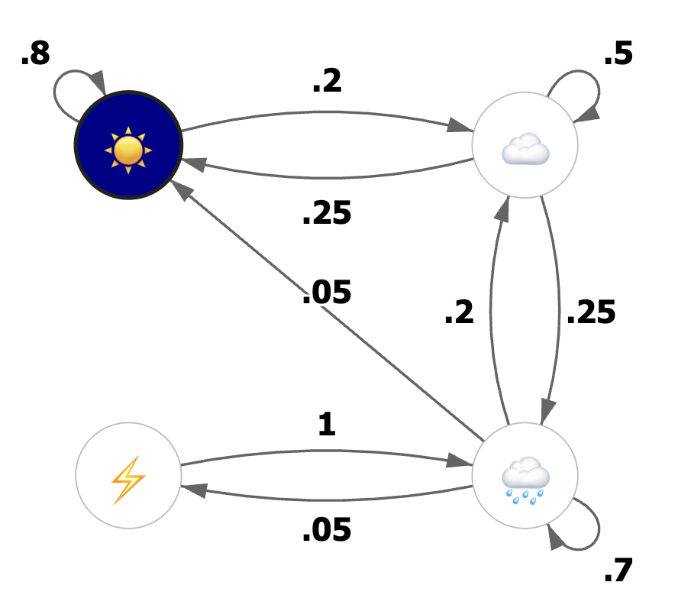
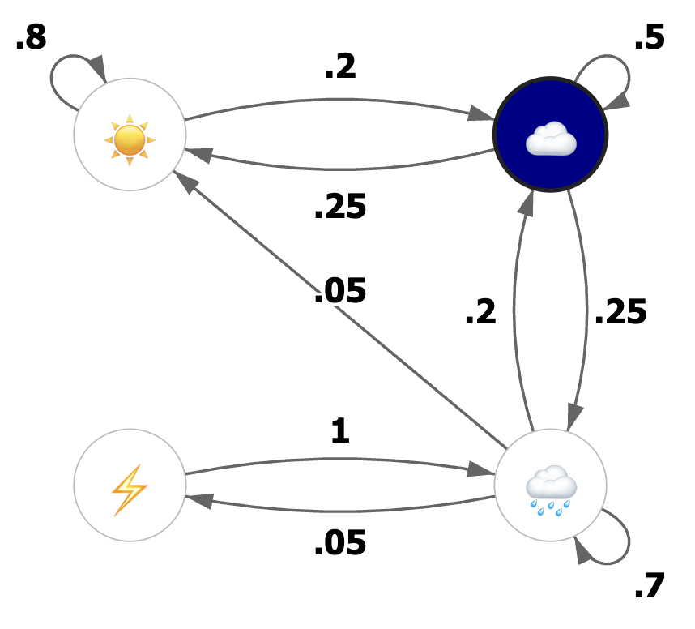
Weather Model
Suppose we have the very crude weather model below.
Example: If sunny now, 80% chance it will be sunny tomorrow.
Example: If cloudy today, 25% chance it will be rainy tomorrow.

Slide 5
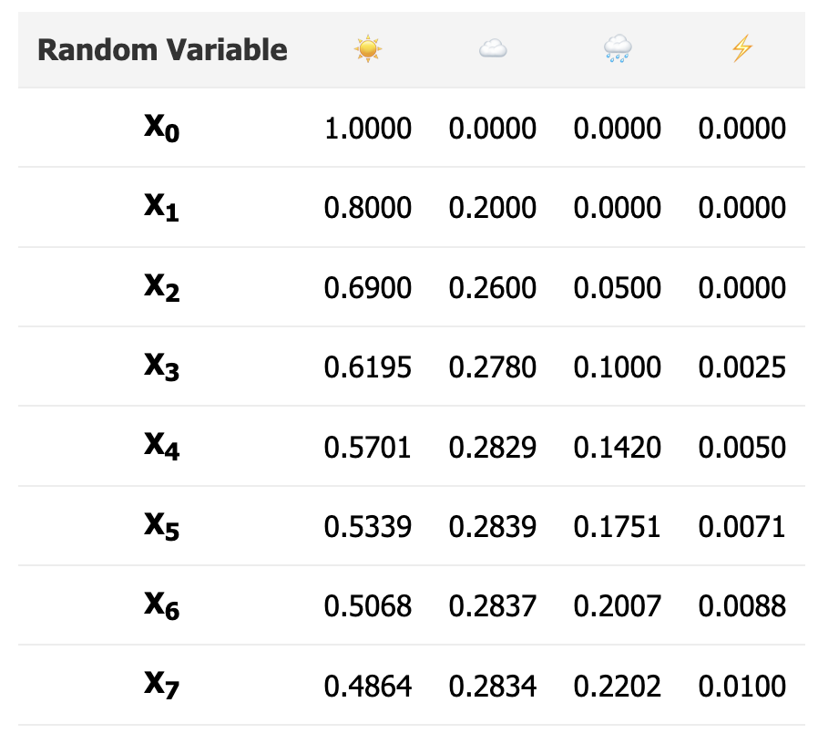
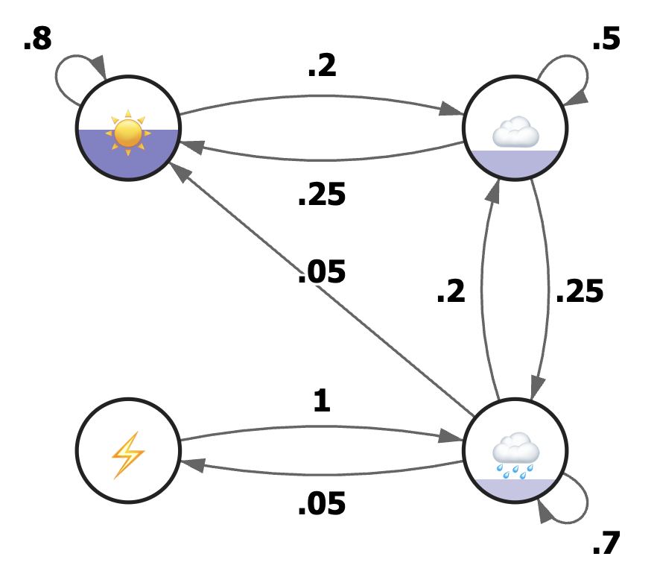
Simulating of Our Weather Model
Let’s run a simulation of this model: https://joshh.ug/cs70/markov_weather.html

Slide 6
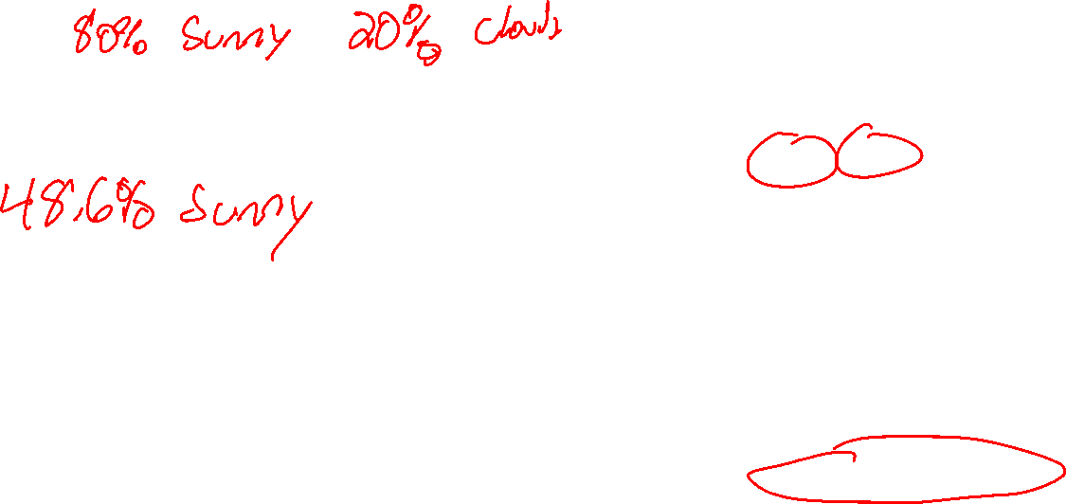
Simulation Results
Results of our simulation are below.
On day 0, we knew it was sunny.
On day 1:
…
On day 7:

Slide 7
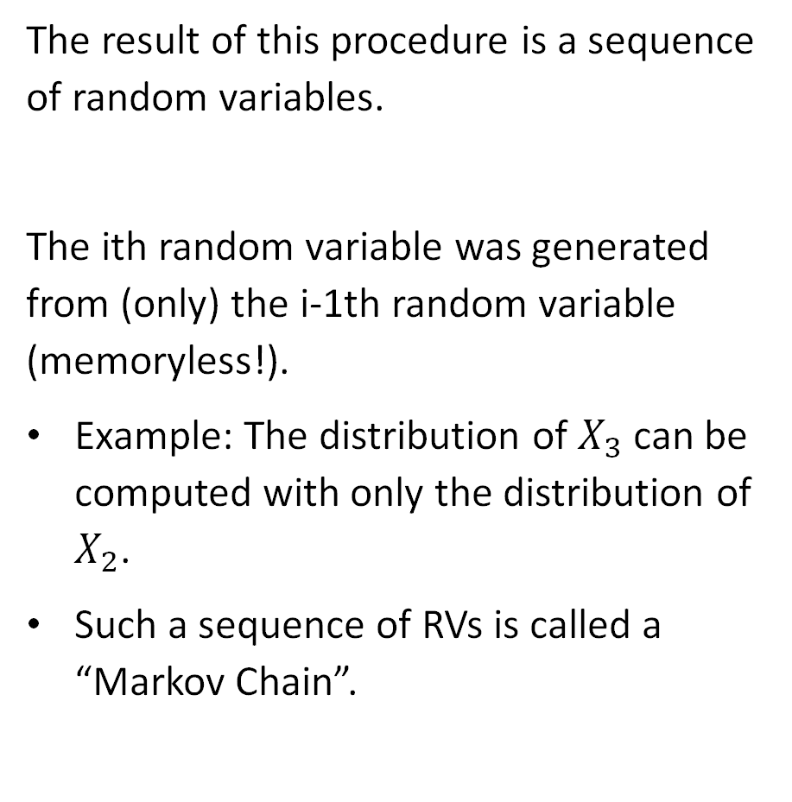
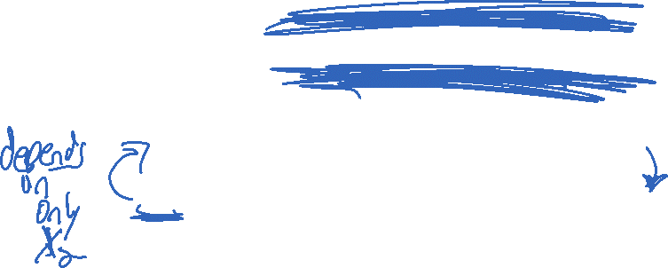
Random Process
The result of this procedure is a sequence of random variables.
The ith random variable was generated from (only) the i-1th random variable (memoryless!).
Example: The distribution of $X_{3}$ can be computed with only the distribution of $X_{2}$.
Such a sequence of RVs is called a “Markov Chain”.

Slide 8
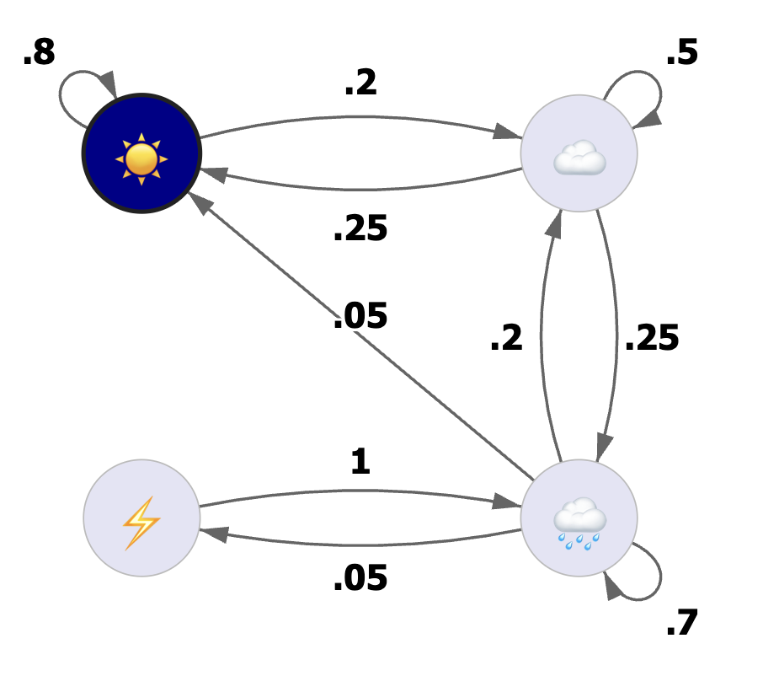

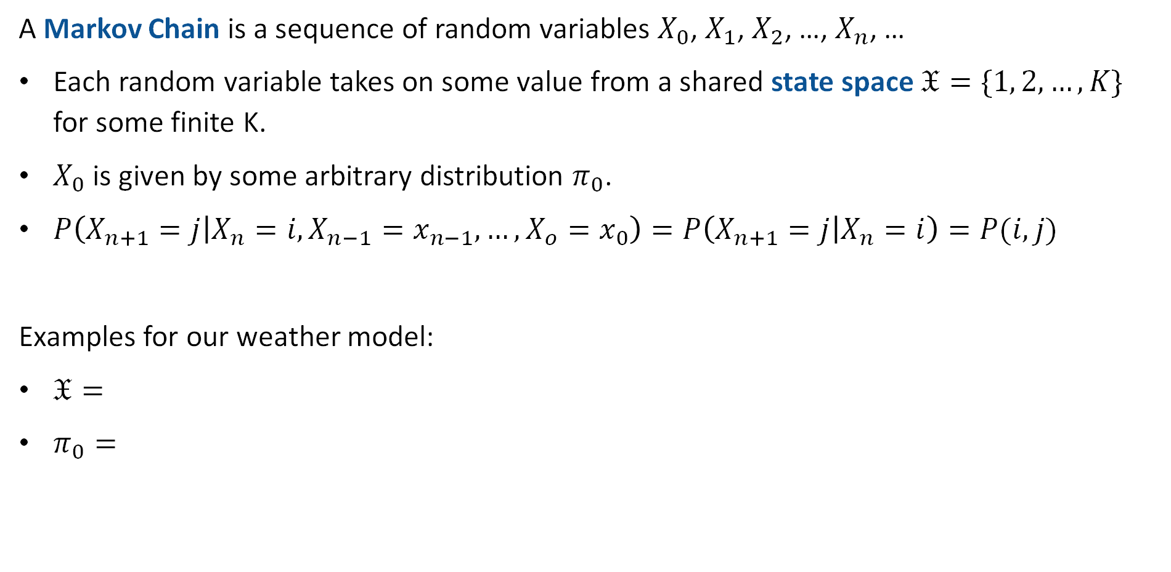



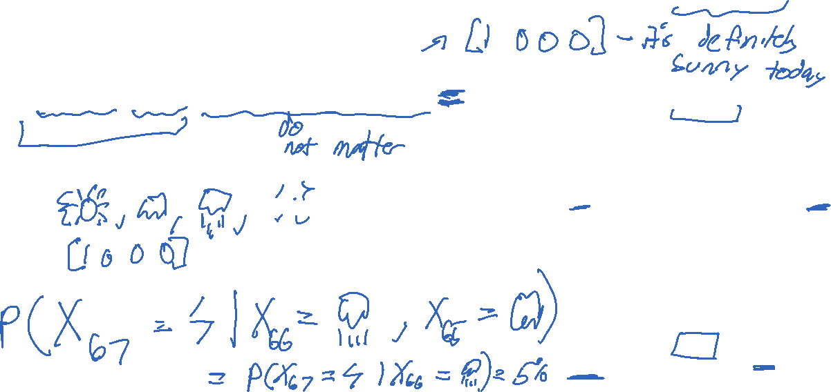
Markov Chain: Formal Definition
A Markov Chain is a sequence of random variables $X_{0}$, $X_{1}$, $X_{2}$, …, $X_{n}$, …
Each random variable takes on some value from a shared state space $𝔛=\{1, 2, …, K\}$ for some finite K.
$X_{0}$ is given by some arbitrary distribution $π_{0}$.
$P\left(X_{n+1}=j | X_{n}=i, X_{n−1}=x_{n−1},…,X_{o}=x_{0}\right)=P\left(X_{n+1}=j | X_{n}=i\right)=P(i,j)$
Examples for our weather model:
$𝔛=$
$π_{0}=$
$$1$$
$$2$$
$$4$$
$$3$$

Slide 9


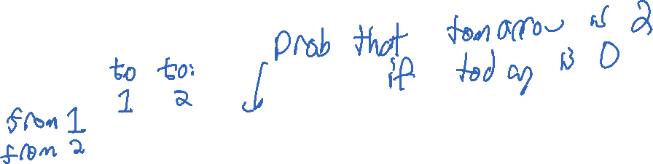
Markov Chain: Matrix Formulation
We can express the conditional probabilities of a Markov Chain using a matrix.
We call this the transition probability matrix.
For our weather model, this matrix is:
$$\left[\begin{matrix}0.8 & 0.2 & 0 & 0 \\ 0.25 & 0.5 & 0.25 & 0 \\ 0.05 & 0.2 & 0.7 & 0.05 \\ 0 & 0 & 1 & 0\end{matrix}\right]$$
$$1$$
$$2$$
$$P\left(X_{67}=4 | X_{66}=3\right)$$
$$4$$
$$3$$

Slide 10



Properties of the Transition Probability Matrix
The state space of a Markov Chain is $𝔛=\{1, 2, …, K\}$ for some finite K.
The transition probability matrix $P$ is a $K×K$ matrix such that:
$$P\left(i, j\right)≥0, ∀i,j∈𝔛$$
and the sum of each row is 1, i.e.
$$\sum_{j=1}^{K}{P\left(i, j\right)=1}, ∀i∈𝔛$$
$$\left[\begin{matrix}0.8 & 0.2 & 0 & 0 \\ 0.25 & 0.5 & 0.25 & 0 \\ 0.05 & 0.2 & 0.7 & 0.05 \\ 0 & 0 & 1 & 0\end{matrix}\right]$$

Slide 11
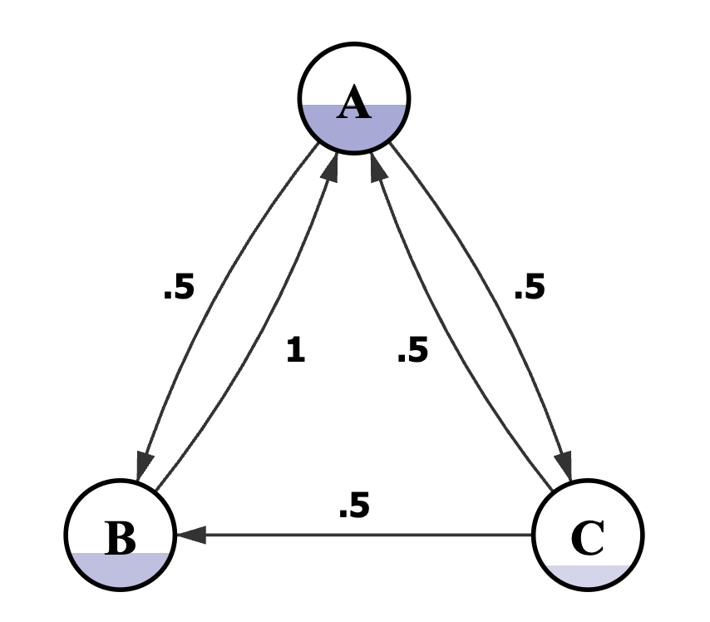
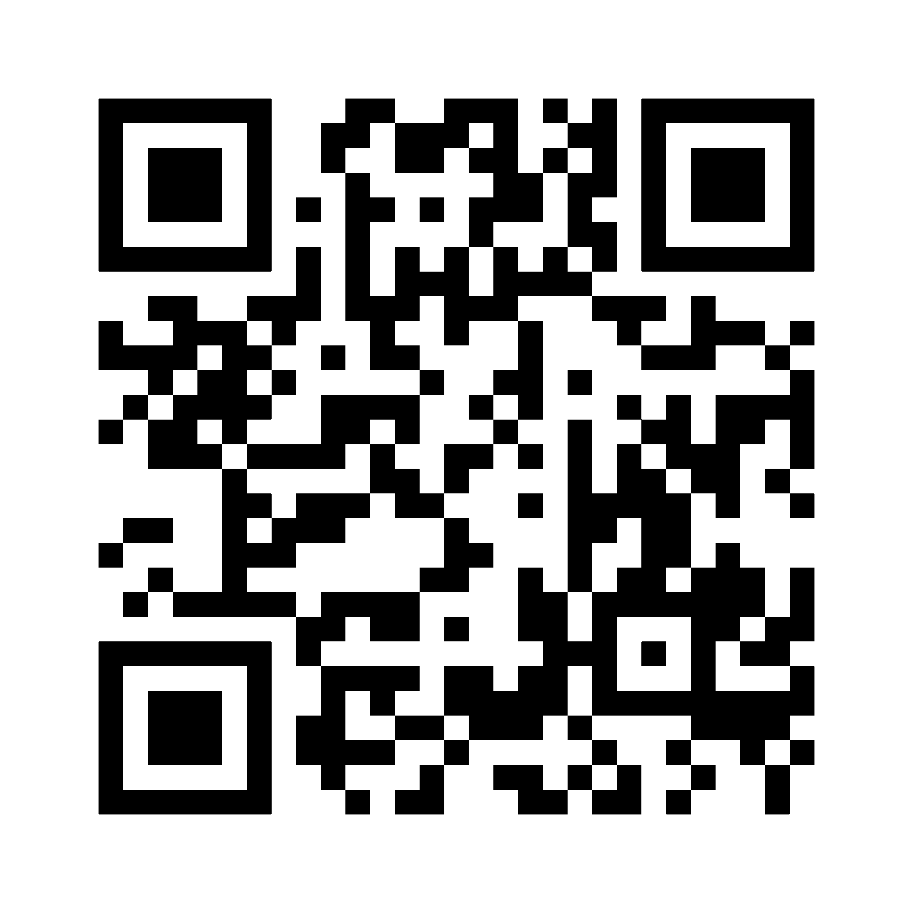
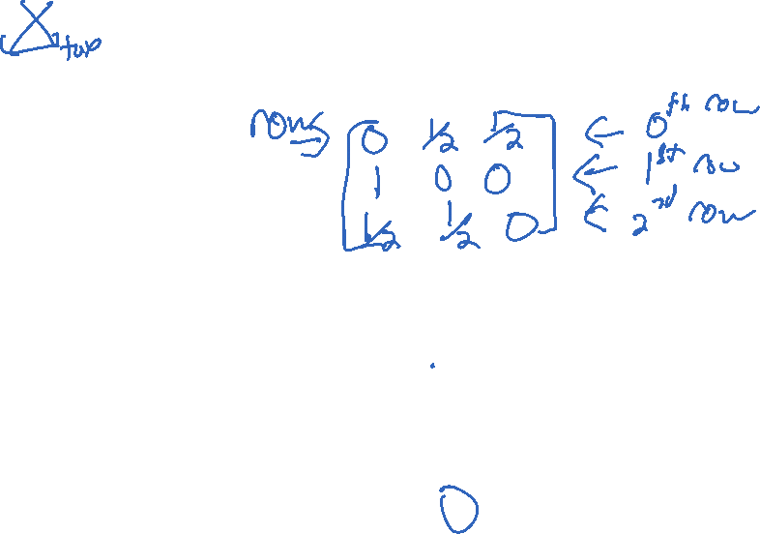
Test Your Understanding
What is the first row of the transition probability matrix for the Markov Chain below?
https://joshh.ug/B

Slide 12
Generating Samples from a Markov Chain
Markov Chain Introduction
Generating Samples from a Markov Chain
Hitting Time
Applications of Hitting Time
Probability of A Before B
The Invariant Distribution
Lecture 25, CS70 Fall 2025

Slide 13
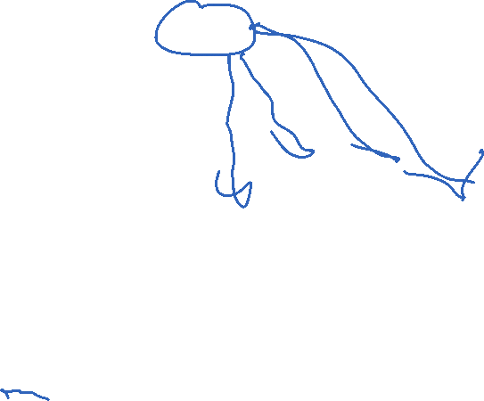
Markov Chain Sample Generation Demo
How we’ve used a Markov Chain so far:
Given a definite state on day 0, what is the probability of all possible states at some later date?
An alternate usage: Generating samples.
Demo:
https://joshh.ug/cs70/markov_weather_sample_generator.html

Slide 14
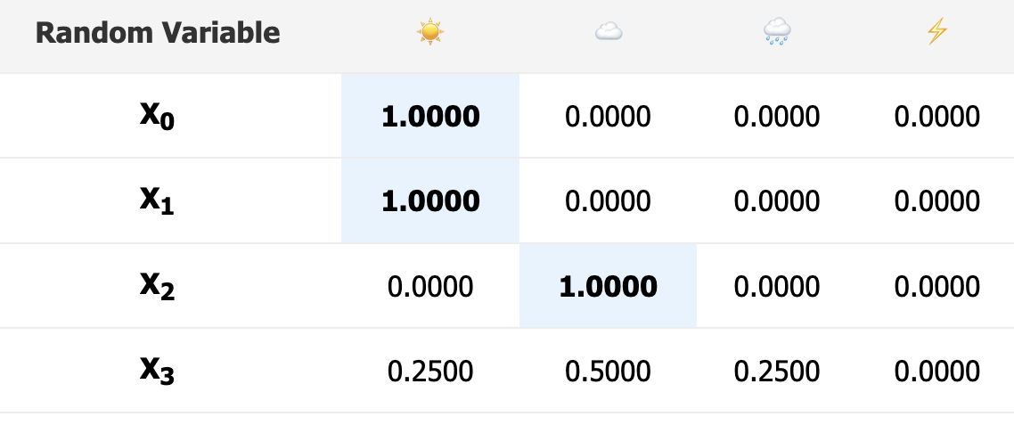
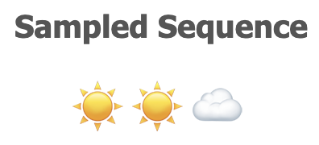
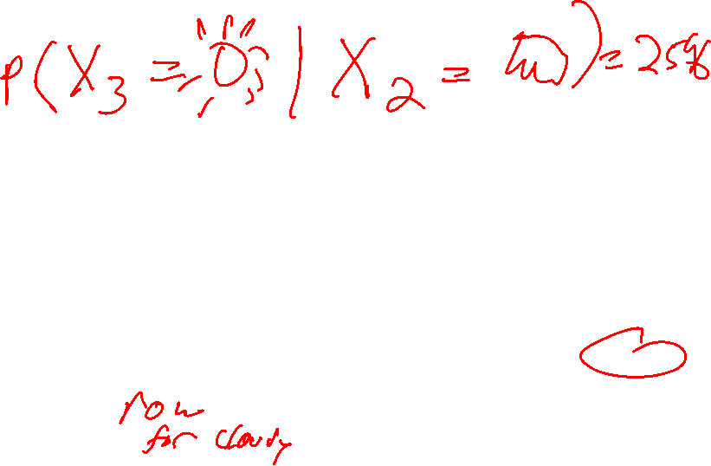
Markov Chain Sample Generation Demo
To generate samples we condition each sample on the output of the previously generated sample.
Example:

Slide 15
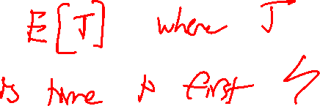
Hitting Time
Markov Chain Introduction
Generating Samples from a Markov Chain
Hitting Time
Applications of Hitting Time
Probability of A Before B
The Invariant Distribution
Lecture 25, CS70 Fall 2025

Slide 16

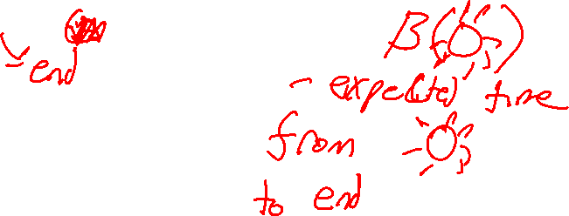
Hitting Time
Another question we might ask ourselves: If we start in state $i$, how any time steps $β\left(i\right)$ do we expect it to take before we hit end state $𝔈$?

Slide 17

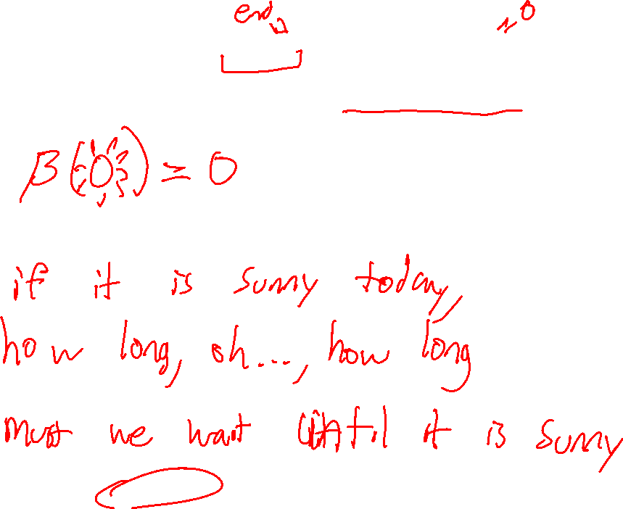
Hitting Time: $β\left(\text{☀️}\right)$
Our desired end state is $𝔈=\text{☀️}$, we want to find $β\left(\text{☀️}\right)\text{, }β\left(\text{☁️}\right)\text{, }β\left(\text{🌧}\text{️}\right)\text{, }\text{and} β\left(\text{⚡}\right)$.
To do this, let’s write the so-called first step equations for this Markov Chain.

Slide 18
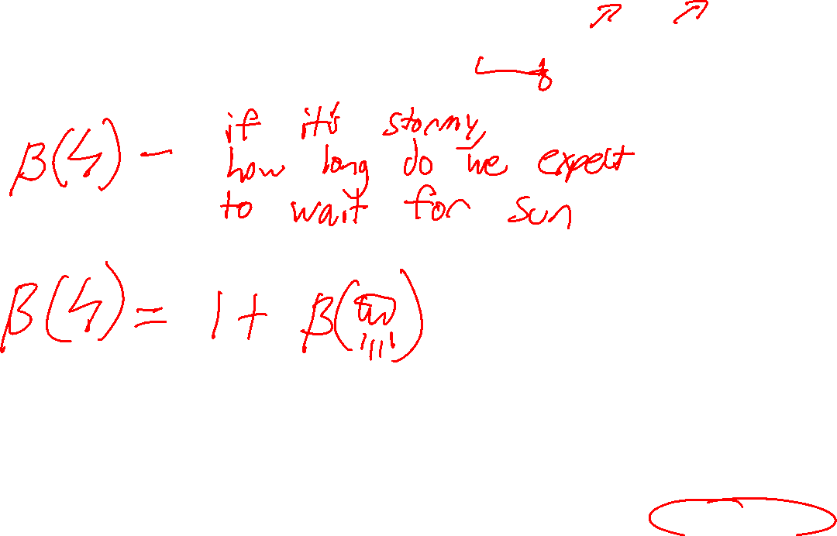

Hitting Time $β\left(\text{⚡}\right)$
Our desired end state is $𝔈=\text{☀️}$, we want to find $β\left(\text{☀️}\right)\text{, }β\left(\text{☁️}\right)\text{, }β\left(\text{🌧}\text{️}\right)\text{, }\text{and} β\left(\text{⚡}\right)$.
To do this, let’s write the so-called first step equations for this Markov Chain.
$$β\left(\text{☀️}\right)=0$$

Slide 19
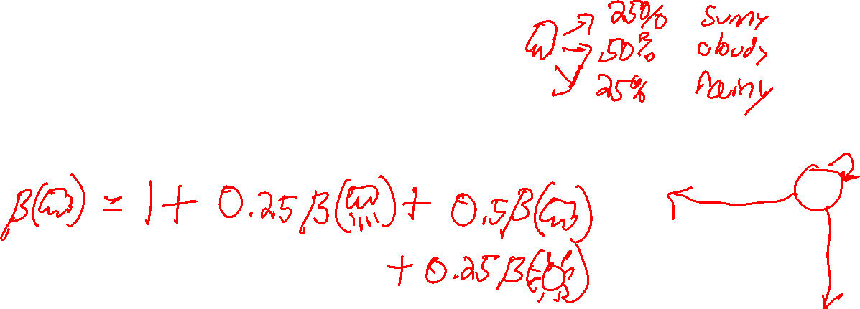
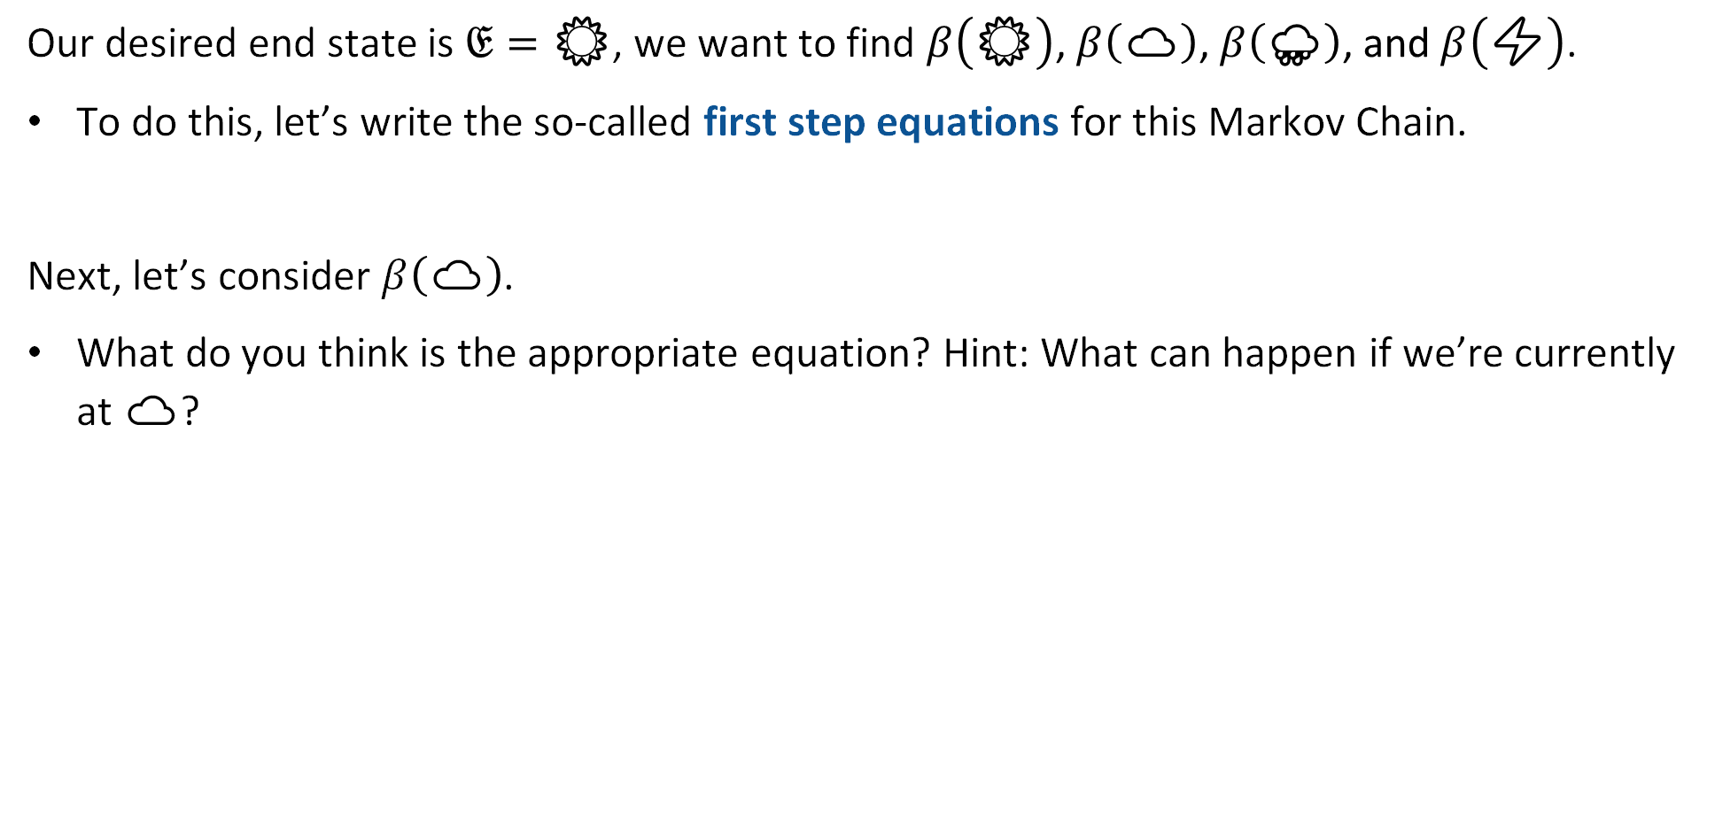

Hitting Time $β\left(\text{☁️}\right)$
Our desired end state is $𝔈=\text{☀️}$, we want to find $β\left(\text{☀️}\right)\text{, }β\left(\text{☁️}\right)\text{, }β\left(\text{🌧}\text{️}\right)\text{, }\text{and} β\left(\text{⚡}\right)$.
To do this, let’s write the so-called first step equations for this Markov Chain.
Next, let’s consider $β\left(\text{☁️}\right)$.
What do you think is the appropriate equation? Hint: What can happen if we’re currently at $\text{☁️}$?
$$β\left(\text{☀️}\right)=0$$
$$β\left(\text{⚡}\right)=1+β\left(\text{🌧}\text{️}\right)$$

Slide 20
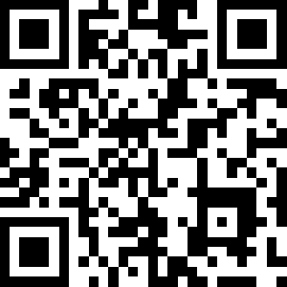
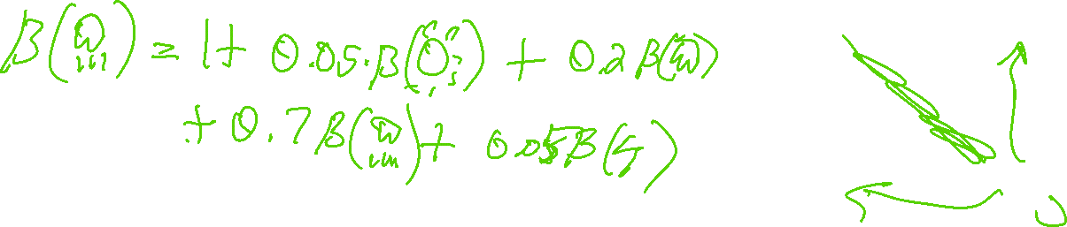

Hitting Time $β\left(\text{🌧}\text{️}\right)$
Our desired end state is $𝔈=\text{☀️}$, we want to find $β\left(\text{☀️}\right)\text{, }β\left(\text{☁️}\right)\text{, }β\left(\text{🌧}\text{️}\right)\text{, }\text{and} β\left(\text{⚡}\right)$.
To do this, let’s write the so-called first step equations for this Markov Chain.
Lastly, let’s consider $β\left(\text{🌧}\text{️}\right)$.
What is it? https://joshh.ug/E
$$β\left(\text{☀️}\right)=0$$
$$β\left(\text{☁️}\right)=1+0.25×β\left(\text{☀️}\right)\text{+}\text{0}\text{.}\text{5}×β\left(\text{☁️}\right)+0.25×β\left(\text{🌧}\text{️}\right)$$
$$β\left(\text{⚡}\right)=1+β\left(\text{🌧}\text{️}\right)$$

Slide 21

Hitting Time
Our desired end state is $𝔈=\text{☀️}$, we want to find $β\left(\text{☀️}\right)\text{, }β\left(\text{☁️}\right)\text{, }β\left(\text{🌧}\text{️}\right)\text{, }\text{and} β\left(\text{⚡}\right)$.
To do this, let’s write the so-called first step equations for this Markov Chain.
Lastly, let’s consider $β\left(\text{🌧}\text{️}\right)$.
$1+0.05×β\left(\text{☀️}\right)+0.2×β\left(\text{☁️}\right)+0.7×β\left(\text{🌧}\text{️}\right)+0.05×β\left(\text{⚡}\right)$
$$β\left(\text{☀️}\right)=0$$
$$β\left(\text{☁️}\right)=1+0.25×β\left(\text{☀️}\right)\text{+}\text{0}\text{.}\text{5}×β\left(\text{☁️}\right)+0.25×β\left(\text{🌧}\text{️}\right)$$
$$β\left(\text{⚡}\right)=1+β\left(\text{🌧}\text{️}\right)$$

Slide 22
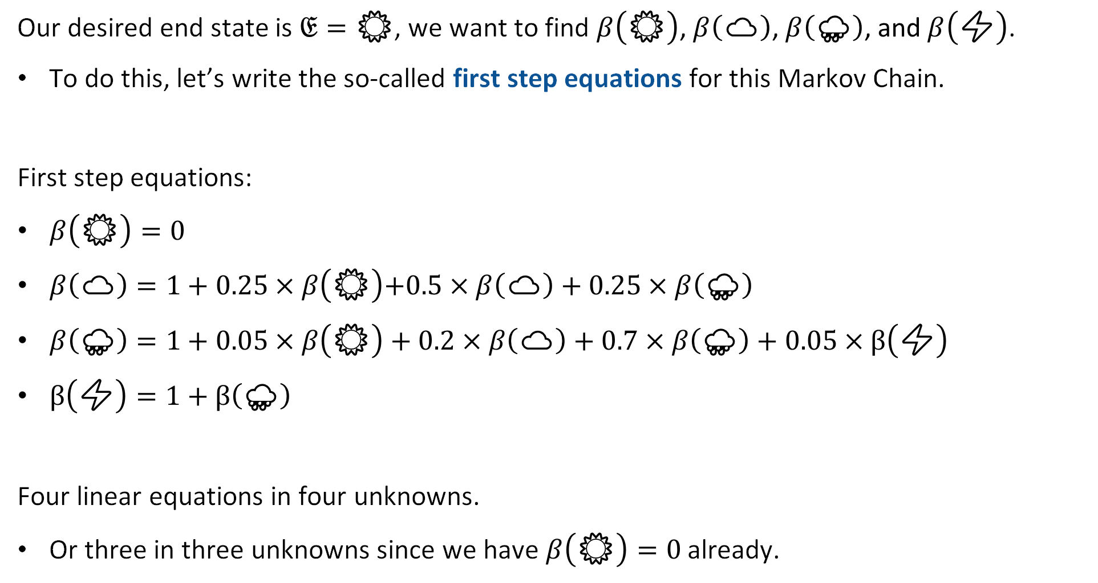
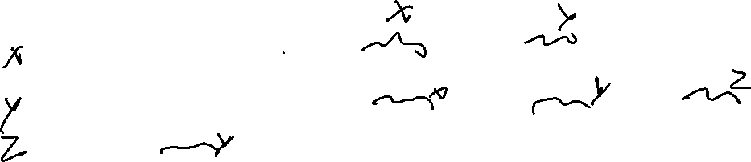
Hitting Time
Our desired end state is $𝔈=\text{☀️}$, we want to find $β\left(\text{☀️}\right)\text{, }β\left(\text{☁️}\right)\text{, }β\left(\text{🌧}\text{️}\right)\text{, }\text{and} β\left(\text{⚡}\right)$.
To do this, let’s write the so-called first step equations for this Markov Chain.
First step equations:
$β\left(\text{☀️}\right)=0$
$β\left(\text{☁️}\right)=1+0.25×β\left(\text{☀️}\right)\text{+}\text{0.5}×β\left(\text{☁️}\right)+0.25×β\left(\text{🌧}\text{️}\right)$
$β\left(\text{🌧}\text{️}\right)=1+0.05×β\left(\text{☀️}\right)+0.2×β\left(\text{☁️}\right)+0.7×β\left(\text{🌧}\text{️}\right)+0.05×β\left(\text{⚡}\right)$
$β\left(\text{⚡}\right)=1+β\left(\text{🌧}\text{️}\right)$
Four linear equations in four unknowns.
Or three in three unknowns since we have $β\left(\text{☀️}\right)=0$ already.

Slide 23

Hitting Time
Answer is given by the system of linear equations:
$β\left(\text{☀️}\right)=0$
$β\left(\text{☁️}\right)=1+0.25×β\left(\text{☀️}\right)\text{+}\text{0.5}×β\left(\text{☁️}\right)+0.25×β\left(\text{🌧}\text{️}\right)$
$β\left(\text{🌧}\text{️}\right)=1+0.05×β\left(\text{☀️}\right)+0.2×β\left(\text{☁️}\right)+0.7×β\left(\text{🌧}\text{️}\right)+0.05×β\left(\text{⚡}\right)$
$β\left(\text{⚡}\right)=1+β\left(\text{🌧}\text{️}\right)$
Straightforward to solve (through substitution, gaussian elimination, computer solver, etc).
If you want to see all the work click here.

Slide 24
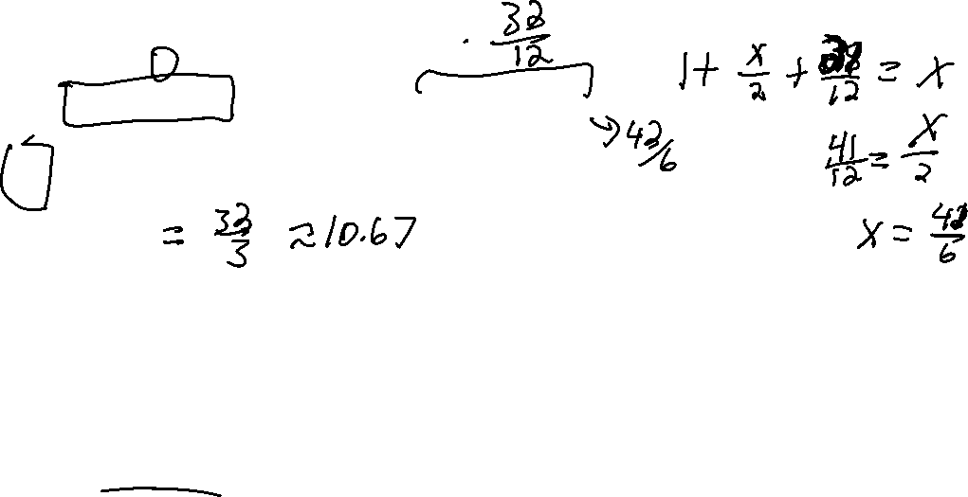
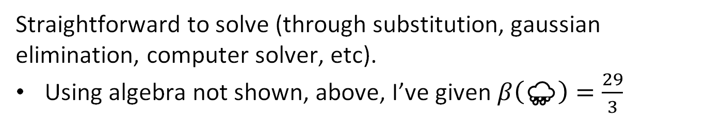

Hitting Time
Answer is given by the system of linear equations:
$β\left(\text{☀️}\right)=0$
$β\left(\text{☁️}\right)=1+0.25×β\left(\text{☀️}\right)\text{+}\text{0.5}×β\left(\text{☁️}\right)+0.25×β\left(\text{🌧}\text{️}\right)$
$β\left(\text{🌧}\text{️}\right)=\frac{29}{3}≈9.67$
$β\left(\text{⚡}\right)=1+β\left(\text{🌧}\text{️}\right)$
Straightforward to solve (through substitution, gaussian elimination, computer solver, etc).
Using algebra not shown, above, I’ve given $β\left(\text{🌧}\text{️}\right)=\frac{29}{3}$

Slide 25
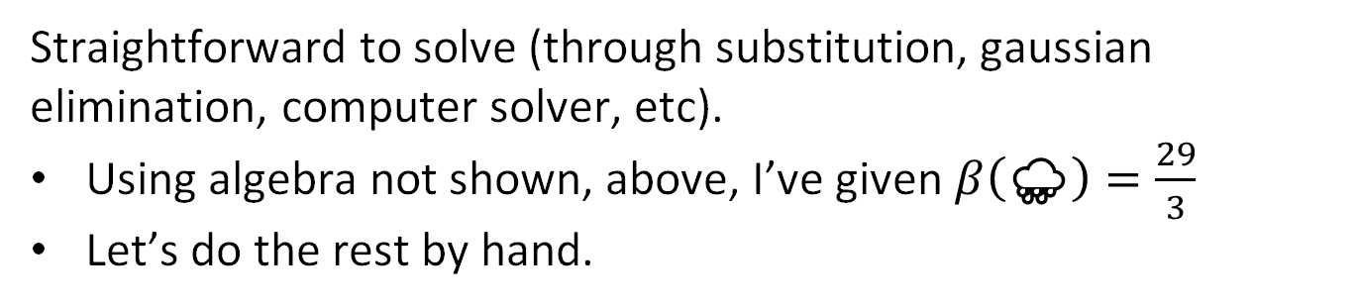
Hitting Time
Answer is given by the system of linear equations:
$β\left(\text{☀️}\right)=0$
$β\left(\text{☁️}\right)=1+0.25×β\left(\text{☀️}\right)\text{+}\text{0.5}×β\left(\text{☁️}\right)+0.25×β\left(\text{🌧}\text{️}\right)$
$β\left(\text{🌧}\text{️}\right)=\frac{29}{3}≈9.67$
$β\left(\text{⚡}\right)=1+β\left(\text{🌧}\text{️}\right)$
Straightforward to solve (through substitution, gaussian elimination, computer solver, etc).
Using algebra not shown, above, I’ve given $β\left(\text{🌧}\text{️}\right)=\frac{29}{3}$
Let’s do the rest by hand.

Slide 26
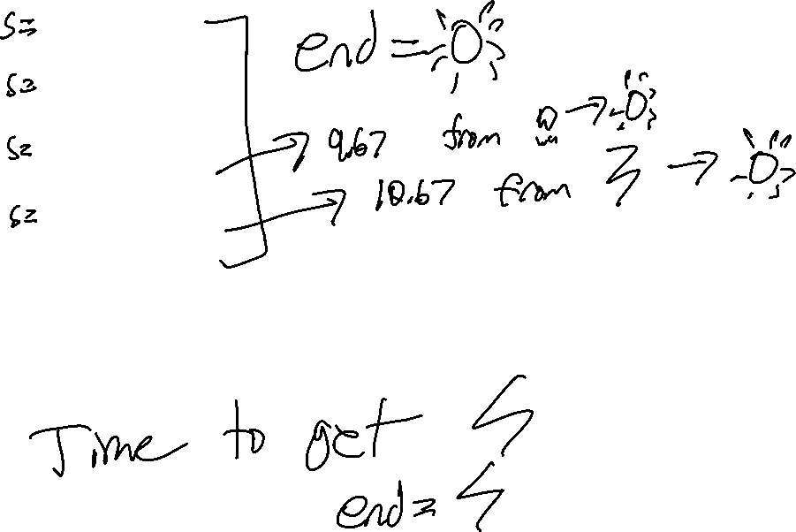

Hitting Time
Answer is given by the system of linear equations:
$β\left(\text{☀️}\right)=0$
$β\left(\text{☁️}\right)=\frac{41}{6}≈6.83$
$β\left(\text{🌧}\text{️}\right)=\frac{29}{3}≈9.67$
$β\left(\text{⚡}\right)=\frac{32}{3}≈10.67$
Interpretation: If it is currently rainy, then it’ll be 9.67 days on average before it is sunny again.

Slide 27


Hitting Time
Hitting time, naturally, depends on our desired state.
Example: If we want the number of steps before it is stormy, i.e. $𝔈=\text{⚡}$ then we’ll have instead that (link):
  $β\left(\text{⚡}\right)=0$
  $β\left(\text{🌧}\text{️}\right)=79$
  $β\left(\text{☁️}\right)=70$
  $β\left(\text{☀️}\right)=84$
The low probability of transition to stormy weather is reflected in the long hitting times from the other three starting states.

Slide 28
Applications of Hitting Time
Markov Chain Introduction
Generating Samples from a Markov Chain
Hitting Time
Applications of Hitting Time
Probability of A Before B
The Invariant Distribution
Lecture 25, CS70 Fall 2025

Slide 29
Application of Hitting Time
Before, we saw how we could apply hitting time analysis to understand how long we have to wait on average for a state in a Markov Model.
We can also frame problems we’ve seen before as Markov Model hitting time problems.
Example: Computing the expectation of a geometric random variable.
New powerful tool that makes our lives easier!

Slide 30
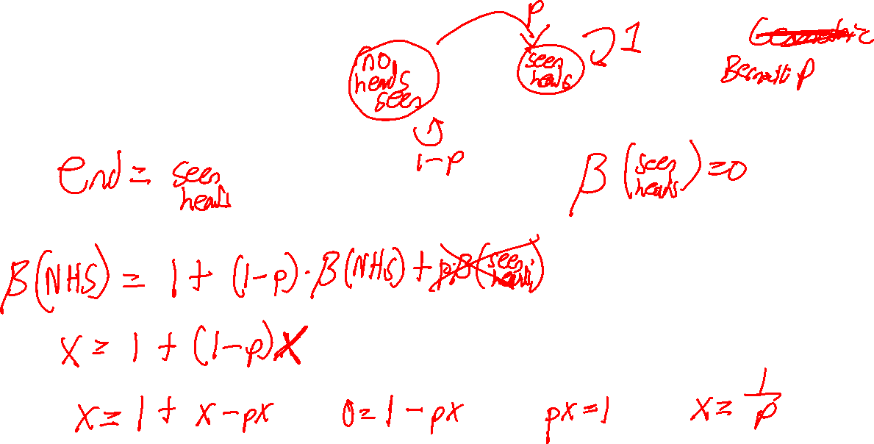
Example: Expectation of a Geometric Random Variable
How can we cast the expectation of a geometric random variable in terms of hitting time?
What are the states of our Markov Model?
What are the probabilities?
What hitting time should we compute?

Slide 31

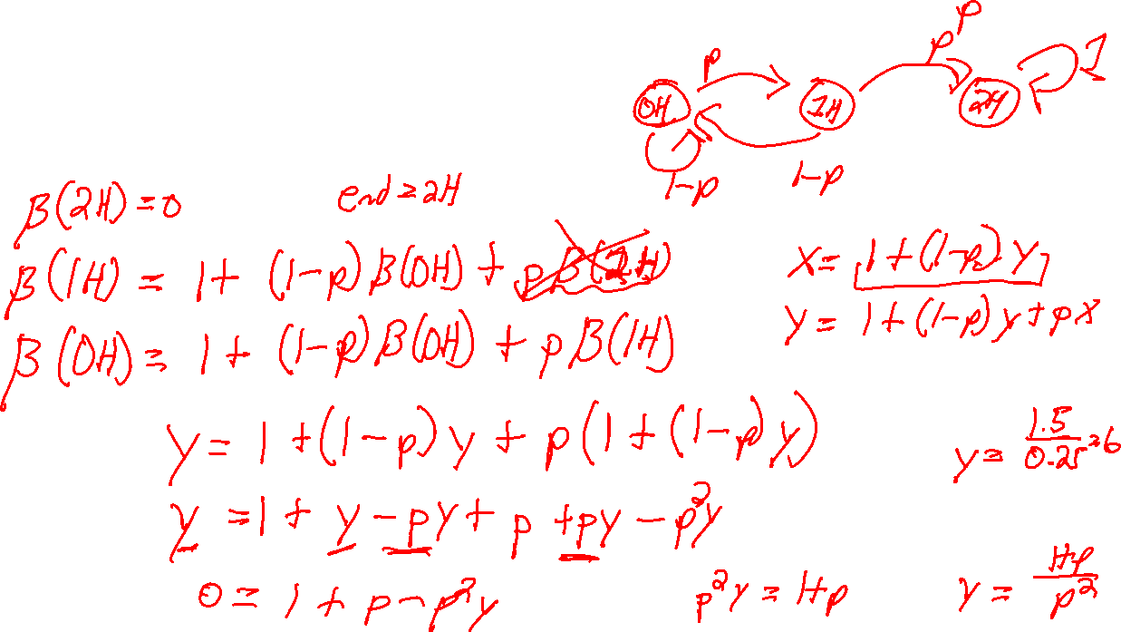
Example 2: Flipping Until Two Consecutive Heads.
Let’s model the process of flipping a coin until we get two consecutive heads.
What does the equivalent Markov Chain look like?
How many flips on average do you think it will take if coin is fair, i.e. $p=0.5$?

Slide 32
Probability of A Before B
Markov Chain Introduction
Generating Samples from a Markov Chain
Hitting Time
Applications of Hitting Time
Probability of A Before B
The Invariant Distribution
Lecture 25, CS70 Fall 2025

Slide 33
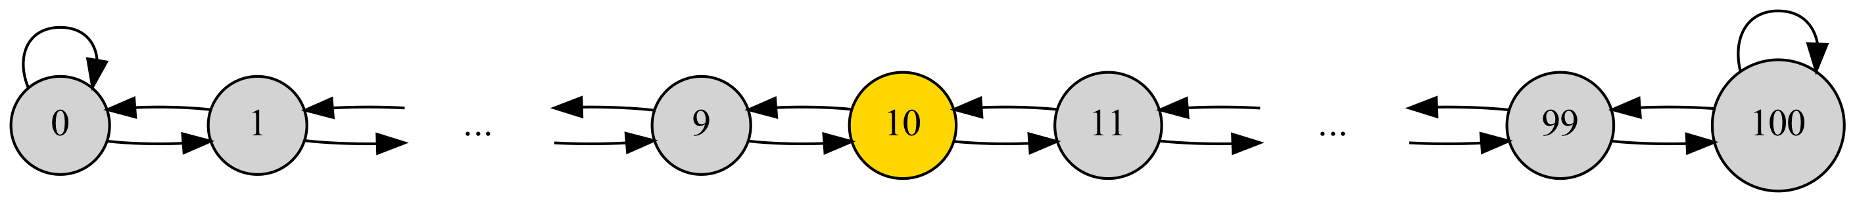
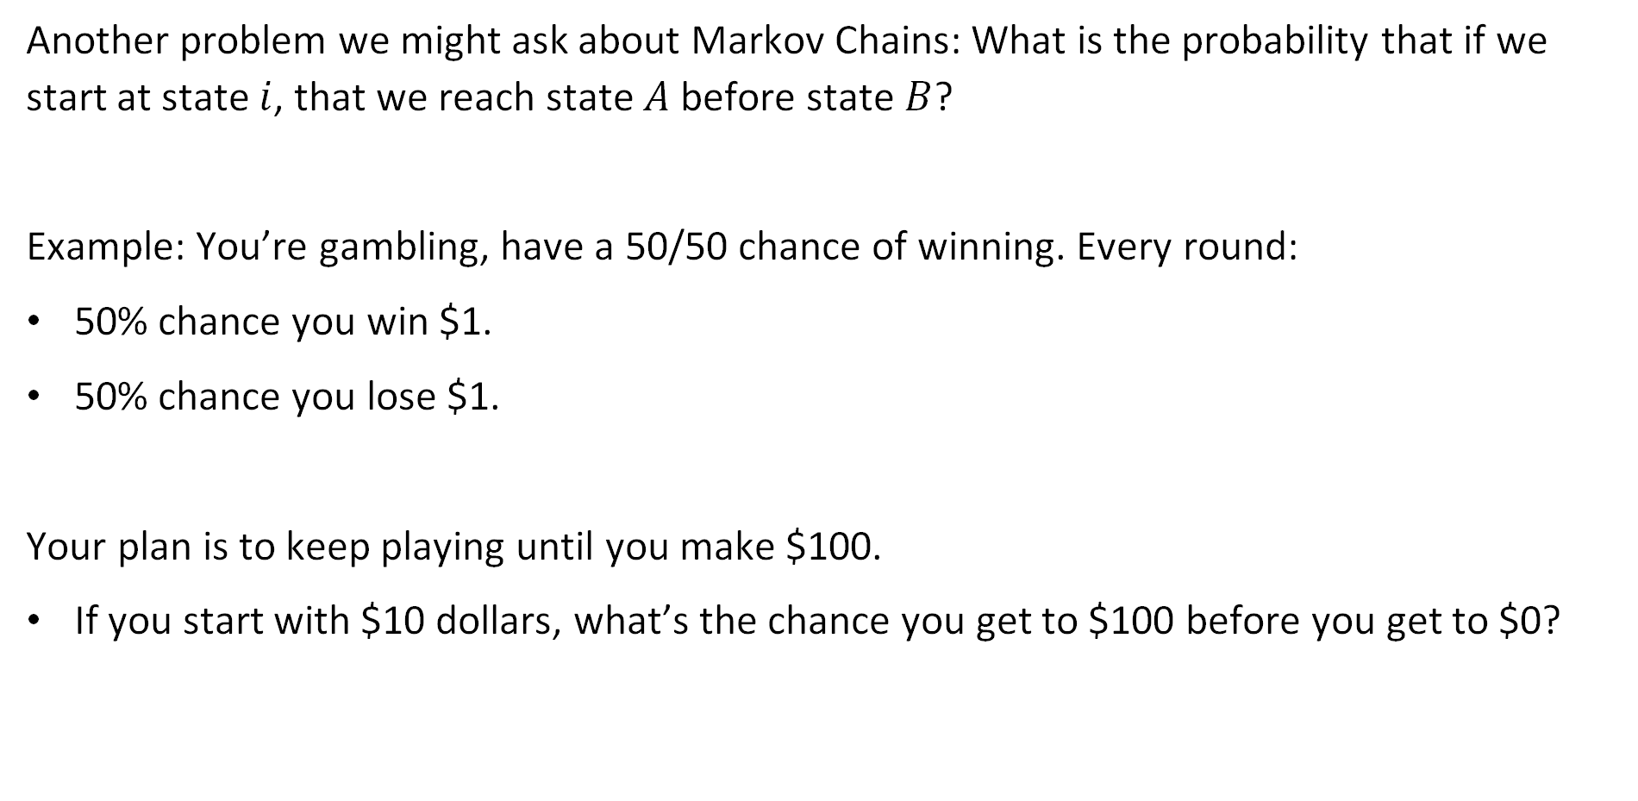
Probability of A Before B
Another problem we might ask about Markov Chains: What is the probability that if we start at state $i$, that we reach state $A$ before state $B$?
Example: You’re gambling, have a 50/50 chance of winning. Every round:
50% chance you win $1.
50% chance you lose $1.
Your plan is to keep playing until you make $100.
If you start with $10 dollars, what’s the chance you get to $100 before you get to $0?

Slide 34


Probability of A Before B
Another problem we might ask about Markov Chains: What is the probability that if we start at state $i$, that we reach state $A=100$ before state $B=0$?
For $i∈\left\{0, 1, …, 100\right\}$. Let $α\left(i\right)$ be the probability of reaching 100 before 0 starting at $i$. Which of these are true?
$α\left(0\right)=0$
$α\left(0\right)=1$
$α\left(100\right)=0$
$α\left(100\right)=1$

Slide 35


Probability of A Before B
Another problem we might ask about Markov Chains: What is the probability that if we start at state $i$, that we reach state $A=100$ before state $B=0$?
For $i∈\left\{0, 1, …, 100\right\}$. Let $α\left(i\right)$ be the probability of reaching 100 before 0 starting at $i$. We know that $α\left(0\right)=0$, $α\left(100\right)=1$. For other $i$, what is $α\left(i\right)$ in terms of $α\left(i−1\right)$ and $α\left(i+1\right)$?

Slide 36


Probability of A Before B
Another problem we might ask about Markov Chains: What is the probability that if we start at state $i$, that we reach state $A=100$ before state $B=0$?
For $i∈\left\{0, 1, …, 100\right\}$. Let $α\left(i\right)$ be the probability of reaching 100 before 0 starting at $i$. We know that $α\left(0\right)=0$, $α\left(100\right)=1$, and $α\left(i\right)=0.5α\left(i−1\right)+0.5α\left(i+1\right)$
Now we have a system of 101 linear equations in 101 unknowns.
Could solve with a computer.
Or we can be clever!

Slide 37



Probability of A Before B
Another problem we might ask about Markov Chains: What is the probability that if we start at state $i$, that we reach state $A=100$ before state $B=0$?
For $i∈\left\{0, 1, …, 100\right\}$. Let $α\left(i\right)$ be the probability of reaching 100 before 0 starting at $i$. We know that $α\left(0\right)=0$, $α\left(100\right)=1$, and $α\left(i\right)=0.5α\left(i−1\right)+0.5α\left(i+1\right)$
Now we have a system of 99 linear equations in 99 unknowns.
Every $α\left(i\right)$ is the average of its left and right neighbor, except leftmost node is 0 and rightmost node is 1. So what is $α\left(i\right)$?
  joshh.ug/F

Slide 38




Probability of A Before B
Now we have a system of 99 linear equations in 99 unknowns.
Every $α\left(i\right)$ is the average of its left and right neighbor, except leftmost node is 0 and rightmost node is 1. So what is $α\left(i\right)$? Must be a straight line starting at $α\left(0\right)=0$ and ending $α\left(100\right)=1$.
$$α\left(i\right)=\frac{i}{100}$$

Slide 39


Probability of A Before B
Another problem we might ask about Markov Chains: What is the probability that if we start at state $i$, that we reach state $A=100$ before state $B=0$?
Example: If we start with $10, there is a 10/100=10% chance that we get to $100 before we get to $0.
$$α\left(i\right)=\frac{i}{100}$$
10%

Slide 40


Example 2: Casino with House Edge
Example: You’re gambling, have a p=48% chance of winning. Every round:
48% chance you win $1.
52% chance you lose $1.
Your plan is to keep playing until you make M=$100.
If you start with $10 dollars, what’s the chance you get to M=$100 before you get to $0? As before $α\left(0\right)=0$, $α\left(100\right)=1$.
  $α\left(i\right)=$
  101 equations with 101 unknowns. Appendix of the notes gives solution.

Slide 41



Example 2: Casino with House Edge
Example: You’re gambling, have a p=48% chance of winning. Every round:
48% chance you win $1.
52% chance you lose $1.
Your plan is to keep playing until you make M=$100.
If you start with $10 dollars, what’s the chance you get to M=$100 before you get to $0?
$$α\left(i\right)=\frac{1−ψ^{i}}{1−ψ^{100}}≈\frac{1}{2440}$$
$$ψ=\frac{1−p}{p}=0.52/0.48$$
i=10

Slide 42


50/50 Odds vs. 48/52 Odds
Visually, we can compare the two situations below.
The tiny house edge makes it extremely difficult to walk away as a winner.

Slide 43
The Invariant Distribution
Markov Chain Introduction
Generating Samples from a Markov Chain
Hitting Time
Applications of Hitting Time
Probability of A Before B
The Invariant Distribution
Lecture 25, CS70 Fall 2025

Slide 44



Three State Markov Chain
Earlier, we saw that if we ran our weather model long enough, we ended up with what we’d call an “Invariant Distribution”.
Invariant because clicking step does nothing.
Let’s examine this behavior more closely.

Slide 45
A Simpler Model
To simplify the math, let’s consider the simpler model below.
Simulation here: https://joshh.ug/cs70/three_state_markov_model.html

Slide 46





Long Term Behavior of Our Three Node Model
We can use linear algebra (sorry) to see long term behavior.
Let $π_{0}$ be a vector giving the probability that we’re in any given state. For our simulation, that means $π_{0}=[1 0 0]$, since we always start in state A.
What is the chance of being in each state at time step 1, i.e. what is $π_{1}$?
https://joshh.ug/C
$$P=\left[\begin{matrix}0 & 0.5 & 0.5 \\ 1 & 0 & 0 \\ 0.5 & 0.5 & 0\end{matrix}\right]$$

Slide 47



Long Term Behavior of Three State Markov Chain
We can use linear algebra (sorry) to see long term behavior.
Let $π_{0}$ be a vector giving the probability that we’re in any given state. For our simulation, that means $π_{0}=[1 0 0]$, then $π_{1}=$
What is the chance of being in each state at time step 1, i.e. what is $π_{1}$?
$$P=\left[\begin{matrix}0 & 0.5 & 0.5 \\ 1 & 0 & 0 \\ 0.5 & 0.5 & 0\end{matrix}\right]$$

Slide 48



Long Term Behavior of Three State Markov Chain
We can use linear algebra (sorry) to see long term behavior.
Let $π_{0}$ be a vector giving the probability that we’re in any given state. For our simulation, that means $π_{0}=[1 0 0]$, then $π_{1}=[0 0.5 0.5]$.
What is the chance of being in each state at time step 2, i.e. what is $π_{2}$?
https://joshh.ug/D
$$P=\left[\begin{matrix}0 & 0.5 & 0.5 \\ 1 & 0 & 0 \\ 0.5 & 0.5 & 0\end{matrix}\right]$$

Slide 49


Long Term Behavior of Three State Markov Chain
We can use linear algebra (sorry) to see long term behavior.
Let $π_{0}$ be a vector giving the probability that we’re in any given state. For our simulation, that means $π_{0}=[1 0 0]$, then $π_{1}=[0 0.5 0.5]$.
What is the chance of being in each state at time step 2, i.e. what is $π_{2}$?
Can reason through the possibilities, or we can use linear algebra!
$$P=\left[\begin{matrix}0 & 0.5 & 0.5 \\ 1 & 0 & 0 \\ 0.5 & 0.5 & 0\end{matrix}\right]$$

Slide 50



Long Term Behavior of Three State Markov Chain
We can use linear algebra (sorry) to see long term behavior.
If $π_{1}=[0 0.5 0.5]$ and $P=\left[\begin{matrix}0 & 0.5 & 0.5 \\ 1 & 0 & 0 \\ 0.5 & 0.5 & 0\end{matrix}\right]$, what is $π_{2}=π_{1}P$?
We did this at the beginning of lecture today!
$π_{2}=π_{1}P=$
$$P=\left[\begin{matrix}0 & 0.5 & 0.5 \\ 1 & 0 & 0 \\ 0.5 & 0.5 & 0\end{matrix}\right]$$

Slide 51


Long Term Behavior of Three State Markov Chain using Linear Algebra
We can use linear algebra (sorry) to see long term behavior.
Let $π_{0}$ be a vector giving the probability that we’re in any given state. For our simulation, that means $π_{0}=[1 0 0]$, then $π_{1}=[0 0.5 0.5]$.
$π_{1}=π_{0}P=\left[0 0.5 0.5\right]$
$π_{2}=π_{1}P=\left[0.75 0.25 0\right]$
$π_{3}=π_{2}P=\left[0.25 0.375 0.375\right]$
$π_{4}=π_{3}P=π_{2}P^{2}=π_{1}P^{3}=π_{0}P^{4}=\left[0.5625 0.3125 0.125\right]$
$π_{5}=π_{0}P^{5}=\left[0.375 0.34375 0.28125\right]$
…
$π_{9}=π_{0}P^{9}=[0.4375 0.33398438 0.22851562]$

Slide 52


Long Term Behavior of Three State Markov Chain using Linear Algebra
We can use linear algebra (sorry) to see long term behavior.
Let $π_{0}$ be a vector giving the probability that we’re in any given state. For our simulation, that means $π_{0}=[1 0 0]$, then $π_{1}=[0 0.5 0.5]$.
$π_{n}=$
Limit as $n→∞$ is
Let’s verify, and also see what happens if we start from a different $π_{0}$: https://joshh.ug/cs70/three_state_markov_model.html

Slide 53

Long Term Behavior of Three State Markov Chain using Linear Algebra
Earlier we saw that if $π_{0}=[1 0 0]$, then $π_{1}=π_{0}P=[0 0.5 0.5]$
More generally: $π_{n}=\left[1 0 0\right]P^{n}$
Limit as $n→∞$ is $\left[\frac{4}{9} \frac{3}{9} \frac{2}{9}\right]$
Let’s see what happens if we start from a different distribution than $π_{0}$.
We observed that no matter where we start, $π_{n}=π_{0}P^{n}$ seems to converge to $\left[\frac{4}{9} \frac{3}{9} \frac{2}{9}\right]$.
In the next lecture, we’ll show that this holds for any starting distribution, not just $π_{0}=[1 0 0]$.

Slide 54
Summary
Markov Chain Introduction
Generating Samples from a Markov Chain
Hitting Time
Applications of Hitting Time
Probability of A Before B
The Invariant Distribution
Lecture 25, CS70 Fall 2025

Slide 55

First Step Equations
A Markov Chain is a series of random variables, s.t.
We know the distribution of $X_{0}$, denoted as $π_{0}$.
We know the transition probability matrix $P$. Rows sum to 1.
Example entry in $P$: $P\left(X_{next}=j | X_{prev}=i\right)=P\left(i,j\right)$
The distribution of kth random variable in the chain is $π_{k}=π_{0}P^{k}$
Usages of Markov Chains:
Generating samples according to some model of the universe.
Hitting time analysis, e.g. expectation of a geometric random variable.
Probability of A before B, e.g. chance of making $100 before running out of money.
Making long term probability forecasts according to some model of the universe.

